Slide 1
SCULPTURAL RELIEF ART
TYPES OF SCULPTURE IN RELIEF

Slide 2
WHAT IS RELIEF?
Relief is a type of sculpture which is developed on two dimensional surface.
Relief is a sculptural technique where the sculpted elements remain attached to a solid background of the same material.
It is supported by a wall as compare to a 3D OR SCULPTURE IN ROUND.
It is considered a sculptural art due to its 3D volume or thickness.
You will understand it more well while experiencing.

Slide 3
Sculpture in round | Sculpture in relief
3D | 2D and 2D&3D
Not supported , independent form | Elements are supported with back ground
 | According to thickness you achieve level
 | Many types
Material : stone, wood paper, paper matche, metal, fiber, plaster, glass etccccc

Slide 4
Types of sculpture in relief
Engravings/Etchings
Sunken relief
Low relief
Bas relief
Alto relief

Slide 5
Engravings

Slide 8
Sunken Relief/ intaglio sunk…below the surface
Sunken-relief, also known as intaglio or hollow-relief, describes an image that is carved into a flat surface, with the images usually mostly linear in nature.
Below the surface

Slide 11
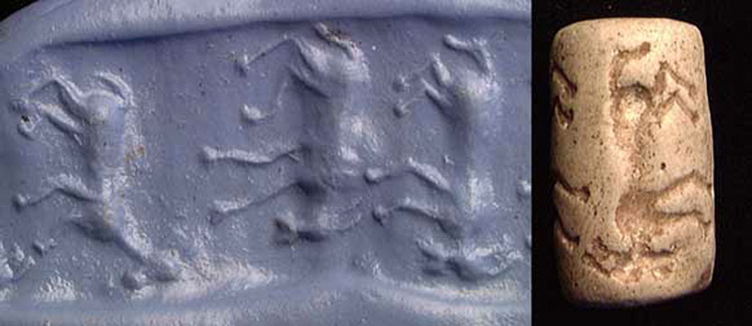

Slide 14
Low Relief 2D
On the surface/above
In a low relief, or bas-relief (basso-relievo), the design projects only slightly from the ground and there is little or no undercutting of outlines

Slide 21
Bas Relief 2D
Above the surface
Bas relief is an artistic technique that involves lightly carving a design into a surface. Most coins have images stamped on them in bas relief. In general, relief makes an artwork look like the picture is raised up from a flat background. There are two types of relief, high and low — or bas — relief.

Slide 22
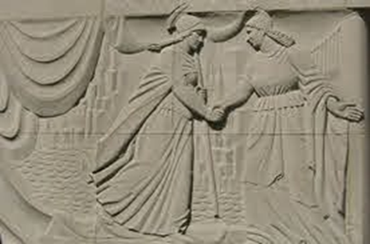

Slide 25
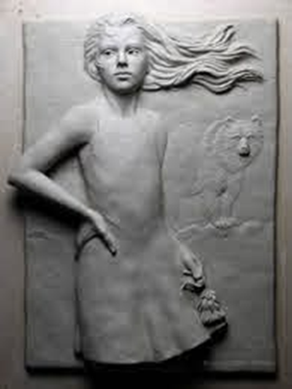

Slide 26
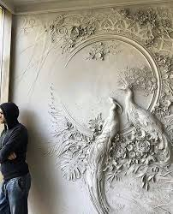

Slide 27
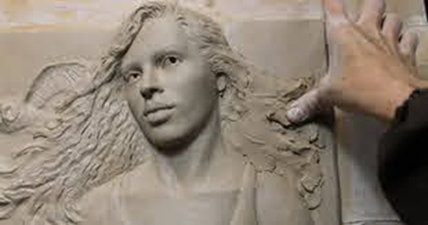

Slide 28
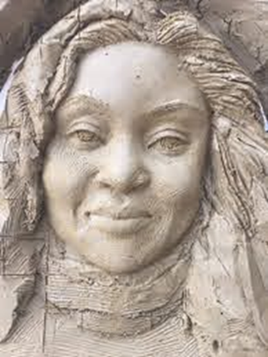

Slide 32
Alto Relief 2D+3D
A sculpture with significant projection from its background.
A 5% to 25% of the design will be mold in 3D sculpture in round, attached from the support but not supported with it.

Slide 34
